Slide 1
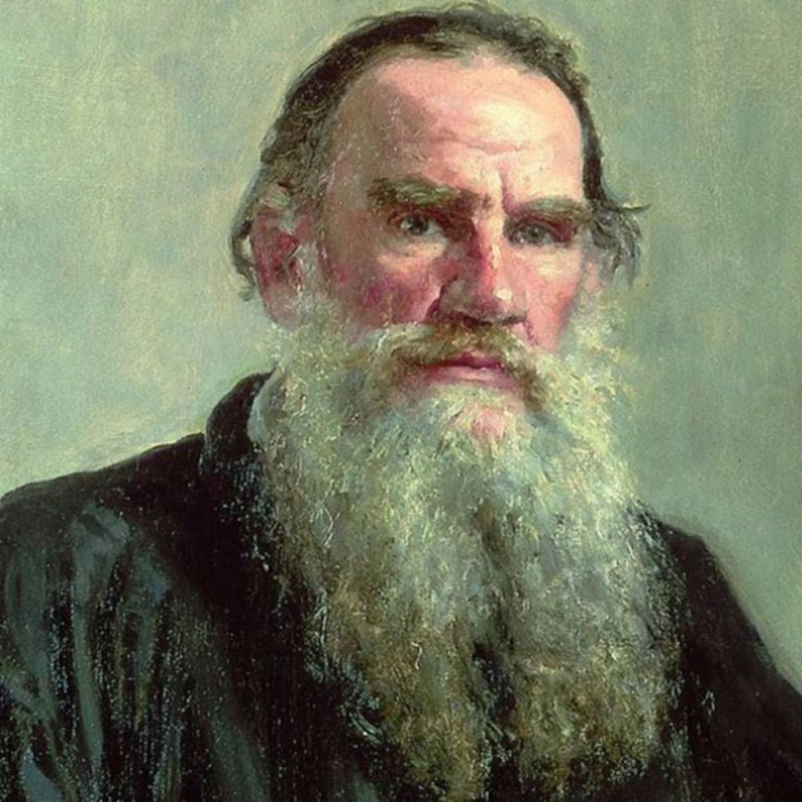

Three Hermits
Leo Tolstoy
Leo Tolstoy (1828-1910) was a Russian writer.
He is reckoned as one of the world’s greatest novelists.
War and Peace and Anna Karenina are two of his widely read novels.
He has to his credit numerous short stories which are popular even today.
His stories contain a memorable message for entire humanity.
As a social reformer, his ideas on non-violent resistance had a great influence on Gandhiji.
history.com (google images)
Jukkalkar Syed Imtiaz
Shri Shivaji College, Chikhli

Slide 2
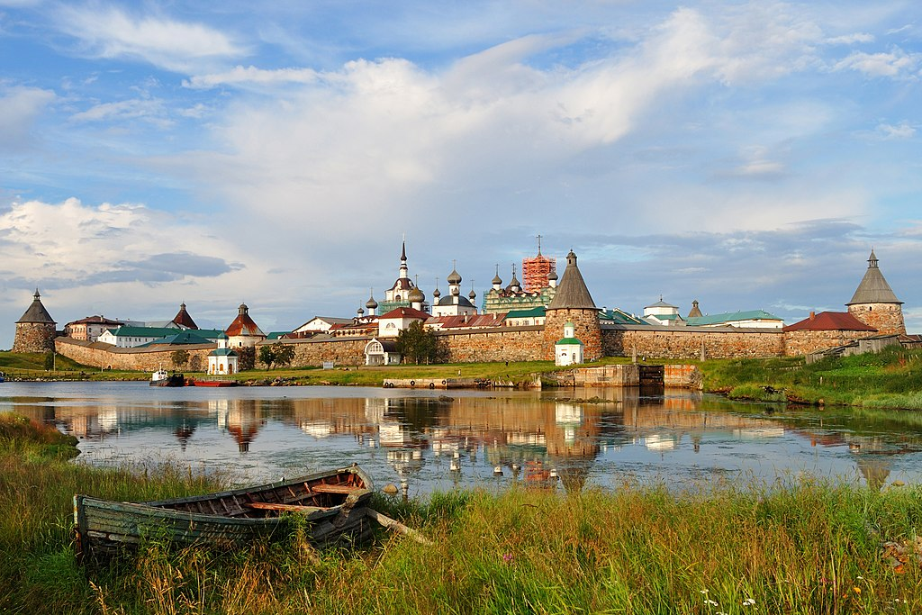
The Story
The Solovetsky Monastery is a fortified monastery located on the Solovetsky Islands in northern Russia.
(https://en.wikipedia.org/wik)
A Bishop was sailing from Archangle to the Solovetsk Monastery.
(Archangle is a city and the administrative city in the north of Western Russia.)
There were number of pilgrims on the vessel. (a large boat or ship)
The atmosphere was very favourable.
The pilgrims lay on the deck eating or sat in groups talking to each other.
There was a Bishop, travelling with the pilgrims. He too came on the deck and found that a group of men were listening to a fisherman, who was pointing towards an island
(Bishop: a priest of high rank who is in charge of the priests of lower rank in a particular area )

Slide 3
The Bishop was curious to know about the discussion going on among the pilgrims.
He asked, “Do not let me disturb you, friends. I came to hear what this good man was saying.”
A fisherman informed him that, there in the distance, lived three hermits on an island for salvation.
As they started sailing towards the island, the Bishop went on asking about the three hermits to the fisherman. The fisherman tells him that once he met the three hermits

Slide 4
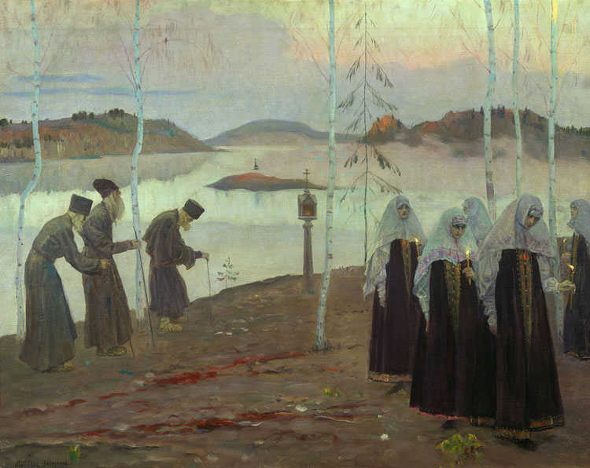
Upon detailed enquiry by the Bishop, the fisherman tells him:
“ They are three men. 'One is a small man and his back is bent. He wears a priest's cassock and is very old; he must be more than a hundred, I should say. He is so old that the white of his beard is taking a greenish tinge, but he is always smiling, and his face is as bright as an angel's from heaven. The second is taller, but he also is very old. He wears tattered, peasant coat. His beard is broad, and of a yellowish grey colour. He is a strong man. Before I had time to help him, he turned my boat over as if it were only a pail. He too, is kindly and cheerful. The third is tall, and has a beard as white as snow and reaching to his knees. He is stern, with over-hanging eyebrows; and he wears nothing but a mat tied round his waist.
Google images

Slide 5
“And did they speak to you.”
While the fisherman was talking they neared the island. Now the Bishop could see a dark streak - which was the island.
As the ship could not move further closer to the island, the captain of the ship arranged a boat for the Bishop to sail to the island.
A boatman rowed the boat with the Bishop to the island. As they were close to, the Bishop looked through his telescope and found that there were three men standing on the shore.
At last they reached the island.
'For the most part they did everything in silence and spoke but little even to one another. One of them would just give a glance, and the others would understand him. I asked the tallest whether they had lived there long. He frowned, and muttered something as if he were angry; but the oldest one took his hand and smiled, and then the tall one was quiet. The oldest one only said: "Have mercy upon us," and smiled.'

Slide 6
The Bishop got out of the boat and said to the three hermits, “'I have heard,' he said, 'that you, godly men, live here saving your own souls, and praying to our Lord Christ for your fellow men. I, an unworthy servant of Christ, am called, by God's mercy, to keep and teach His flock. I wished to see you, servants of God, and to do what I can to teach you, also.'
The old men looked at each other smiling, but remained silent.
'Tell me,' said the Bishop, 'what you are doing to save your souls, and how you serve God on this island.'
The second hermit sighed, and looked at the oldest, the very ancient one. The latter smiled, and said:
'We do not know how to serve God. We only serve and support ourselves, servant of God.'
'But how do you pray to God?' asked the Bishop.
'We pray in this way,' replied the hermit. 'Three are ye, three are we, have mercy upon us.'
And when the old man said this, all three raised their eyes to heaven, and repeated:
'Three are ye, three are we, have mercy upon us!'
The Bishop smiled.

Slide 7
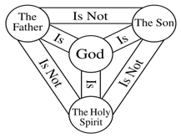
'You have evidently heard something about the Holy Trinity,' said he. 'But you do not pray aright. You have won my affection, godly men. I see you wish to please the Lord, but you do not know how to serve Him. That is not the way to pray; but listen to me, and I will teach you. I will teach you, not a way of my own, but the way in which God in the Holy Scriptures has commanded all men to pray to Him.'
And the Bishop began explaining to the hermits how God had revealed Himself to men; telling them of God the Father, and God the Son, and God the Holy Ghost.
'God the Son came down on earth,' said he, 'to save men, and this is how He taught us all to pray. Listen and repeat after me: "Our Father."'
And the first old man repeated after him, 'Our Father,' and the second said, 'Our Father,' and the third said, 'Our Father.'
'Which art in heaven,' continued the Bishop.
Holy Trinity: The Christian doctrine of the Trinity … holds that God is one God, and exists in the form of three the Father, the Son (Jesus) and the Holy Spirit. The three persons are distinct, yet are one "substance, essence or nature". (wiki)

Slide 8
The first hermit repeated, 'Which art in heaven,' but the second blundered over the words, and the tall hermit could not say them properly. His hair had grown over his mouth so that he could not speak plainly. The very old hermit, having no teeth, also mumbled indistinctly.
The Bishop repeated the words again, and the old men repeated them after him. The Bishop sat down on a stone, and the old men stood before him, watching his mouth, and repeating the words as he uttered them. And all day long the Bishop laboured, saying a word twenty, thirty, a hundred times over, and the old men repeated it after him. They blundered, and he corrected them, and made them begin again.
The Bishop did not leave off till he had taught them the whole of the Lord's prayer so that they could not only repeat it after him, but could say it by themselves. The middle one was the first to know it, and to repeat the whole of it alone. The Bishop made him say it again and again, and at last the others could say it too.
It was getting dark. The Bishop returned to the vessel.
The pilgrims lay down to sleep, and all was quiet on deck. The Bishop did not wish to sleep, but sat alone at the stern, gazing at the sea where the island was no longer visible, and thinking of the good old men. He thought how pleased they had been to learn the Lord's prayer; and he thanked God for having sent him to teach and help such godly men.
After some time, the Bishop saw something white and shining, on the bright path which the moon cast across the sea. Was it a seagull, or the little gleaming sail of some small boat? The Bishop fixed his eyes on it, wondering.

Slide 9
'Look there, what is that, my friend? What is it?' the Bishop repeated, though he could now see plainly what it was -- the three hermits running upon the water, all gleaming white, their grey beards shining, and approaching the ship as quickly as though it were morning.
The steersman looked and let go the helm in terror.
'Oh Lord! The hermits are running after us on the water as though it were dry land!'
The passengers hearing him, jumped up, and crowded to the stern. They saw the hermits coming along hand in hand, and the two outer ones beckoning the ship to stop. All three were gliding along upon the water without moving their feet. Before the ship could be stopped, the hermits had reached it, and raising their heads, all three as with one voice, began to say:
'We have forgotten your teaching, servant of God. As long as we kept repeating it we remembered, but when we stopped saying it for a time, a word dropped out, and now it has all gone to pieces. We can remember nothing of it. Teach us again.'
The Bishop crossed himself, and leaning over the ship's side, said:
'Your own prayer will reach the Lord, men of God. It is not for me to teach you. Pray for us sinners.
And the Bishop bowed low before the old men; and they turned and went back across the sea. And a light shone until daybreak on the spot where they were lost to sight.

Slide 10
Moral Lesson
Through this short story, Tolstoy shows -
How individual beliefs triumph over religious dogma.
“And in praying use not vain repetitions, as the Gentiles do: for they think that they shall be heard for their much speaking. Be not therefore like unto them: for your Father knoweth what things ye have need of, before ye ask Him.”
—Matthew (vi. 7, 8)
Tolstoy , through this story criticises organised religion, particularly, the Russian Orthodox Church for sanctioning exploitation of commons.

